Slide 1
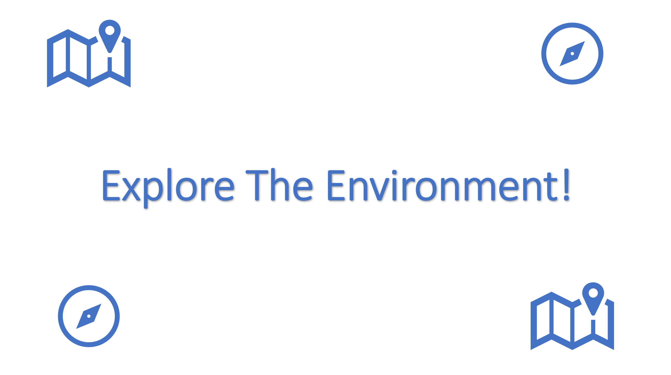
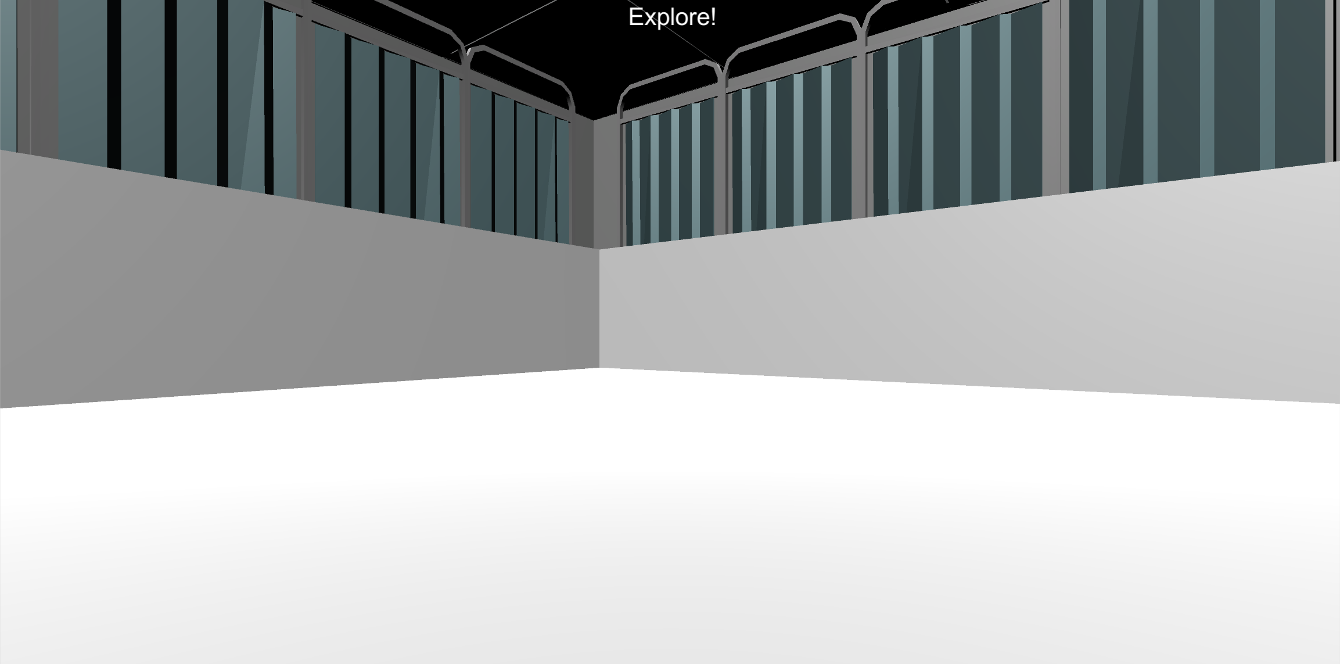
Welcome!
In this first section of the experiment your job is to explore the 3D environment pictured below. On each Explore Round you will see the Explore The Environment screen and then you will be placed into the environment at a random location.

Slide 2
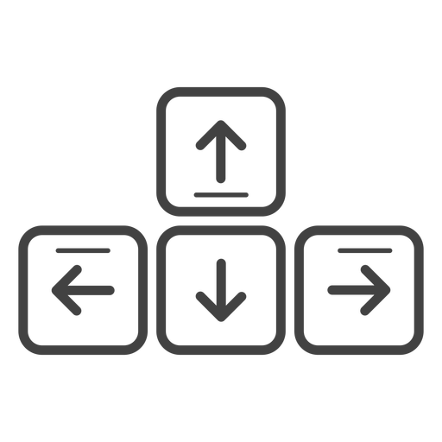
MOVEMENT CONTROLS
To move around the environment, you’ll use the Up-Arrow to move forward, and the left and right arrow-keys to rotate.
Move Forward
Rotate
Left
Rotate
Right

Slide 3
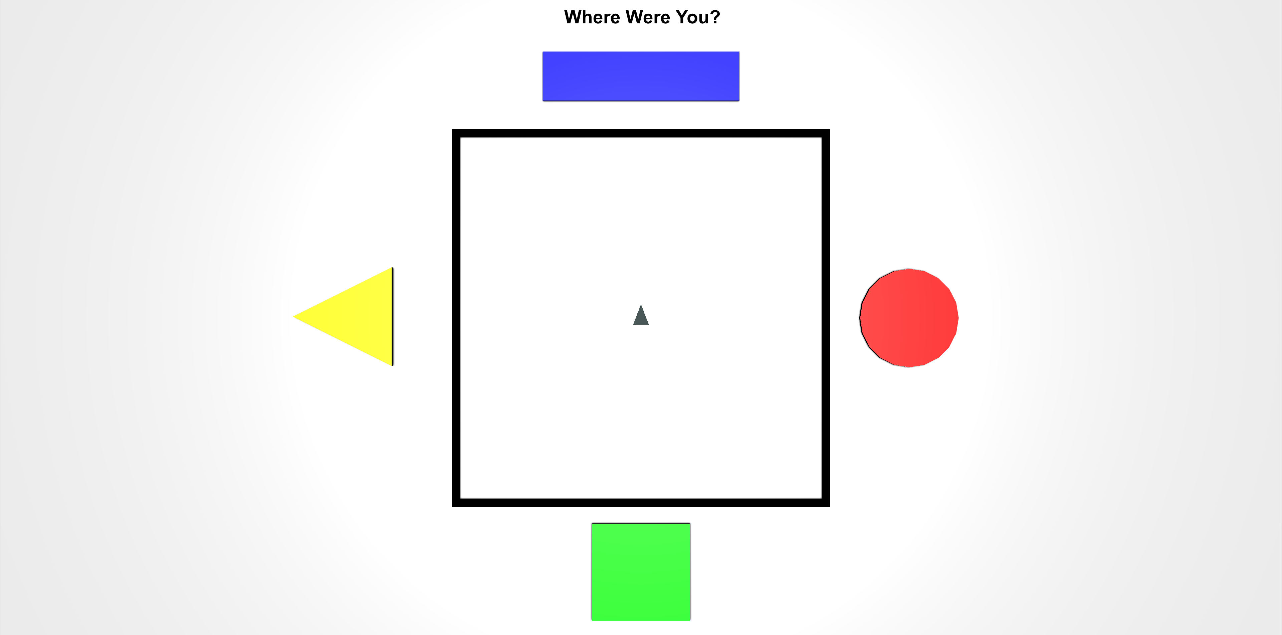
TOP-DOWN VIEW
While exploring the environment, you will be asked periodically to locate your position from a top-down viewpoint like the picture below.
The grey triangle in the middle shows the direction that you’re facing, and the controls are the same as the 3D environment. Move the grey triangle to the last position you were in, in the 3D environment, and then press the Spacebar.

Slide 4

DO YOU HAVE ANY QUESTIONS?
When you’re ready, place your right hand on the arrow keys and press the Spacebar with your left to continue!
Spacebar

Slide 5


Explore The Environment!

Slide 6
Great Job!
Now you will get to explore on your own, switching between the 3D environment and the top-down view.
Remember! When you’re in the top down view, go to the last position that you were exploring in and press the Spacebar.

Slide 7
Do you have any questions about this portion of the experiment? The experimenter will now leave the room and let you continue on your own. When this portion of the experiment is over you will be asked to notify the experimenter.
Spacebar
Place your right hand on the arrow keys and press the Spacebar with your left to continue!

Slide 8
Great Work! Please notify the experimenter that you have completed this portion of the experiment.

Slide 9
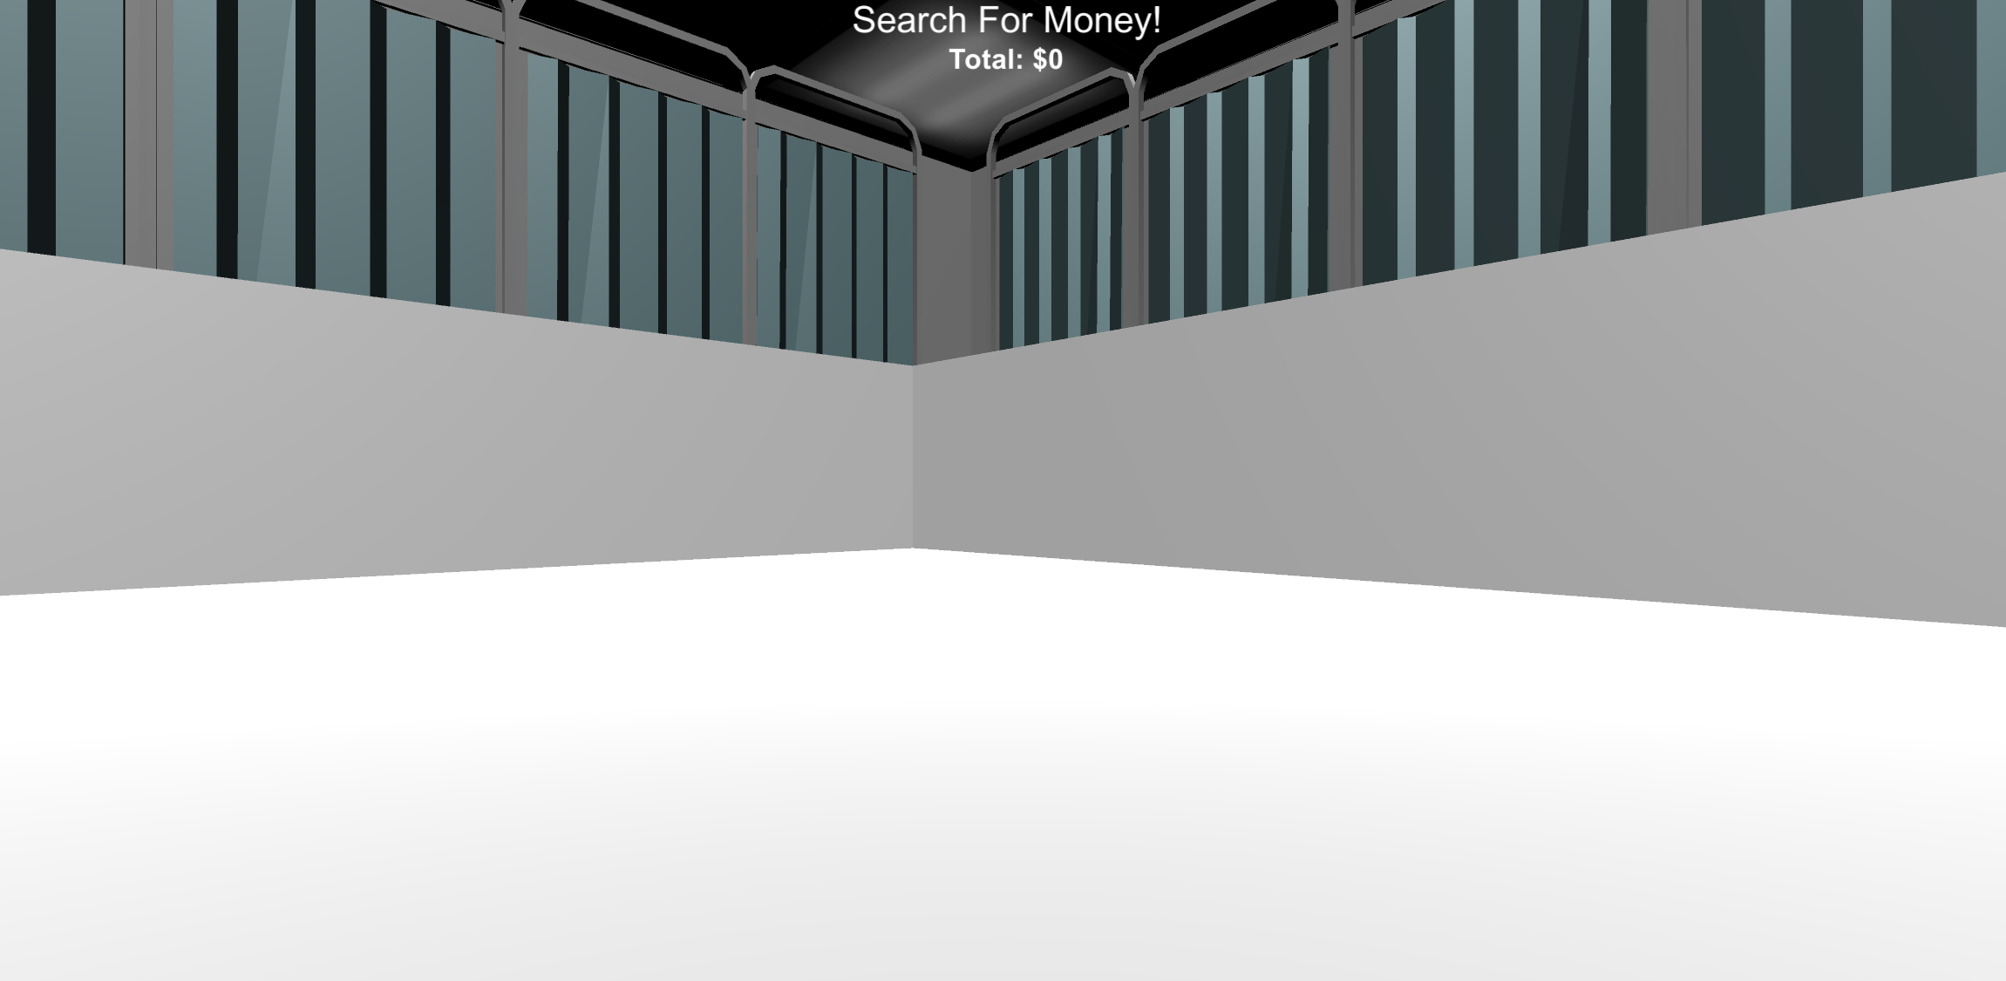

FINDING MONEY
Your next task is to find money in the environment. The money will be invisible but when you find it you will hear a collection sound and it will be added to your Money Total which you’ll see at the top of your screen.
Let’s practice finding some! Keep moving around the environment until you collect $0.10 worth of money!
Money Total

Slide 10

Please put the headphones on, and allow the experimenter to show you how to adjust the volume

Slide 11

MONEY COLLECTION ROUNDS
Now that you know how to find money, you next task is to collect as much as possible in each of the following Money Collection Rounds.
At the start of each round you will see a “Search For Money” screen, and then you will be placed into the environment at a random location. Once in the environment you will have 1-minute to collect as much money as possible.

Slide 12

NO FEEDBACK ROUNDS
On some rounds you won’t receive any feedback:
no sound and no collection total!
On these trials you will see the “Search For Money! NO FEEDBACK” screen before being placed into the environment. You will still be collecting money; however you won't find out how much you collected on these rounds until the end of this session!
HINT: Use what you’ve learned from previous rounds to guide your search!

Slide 13
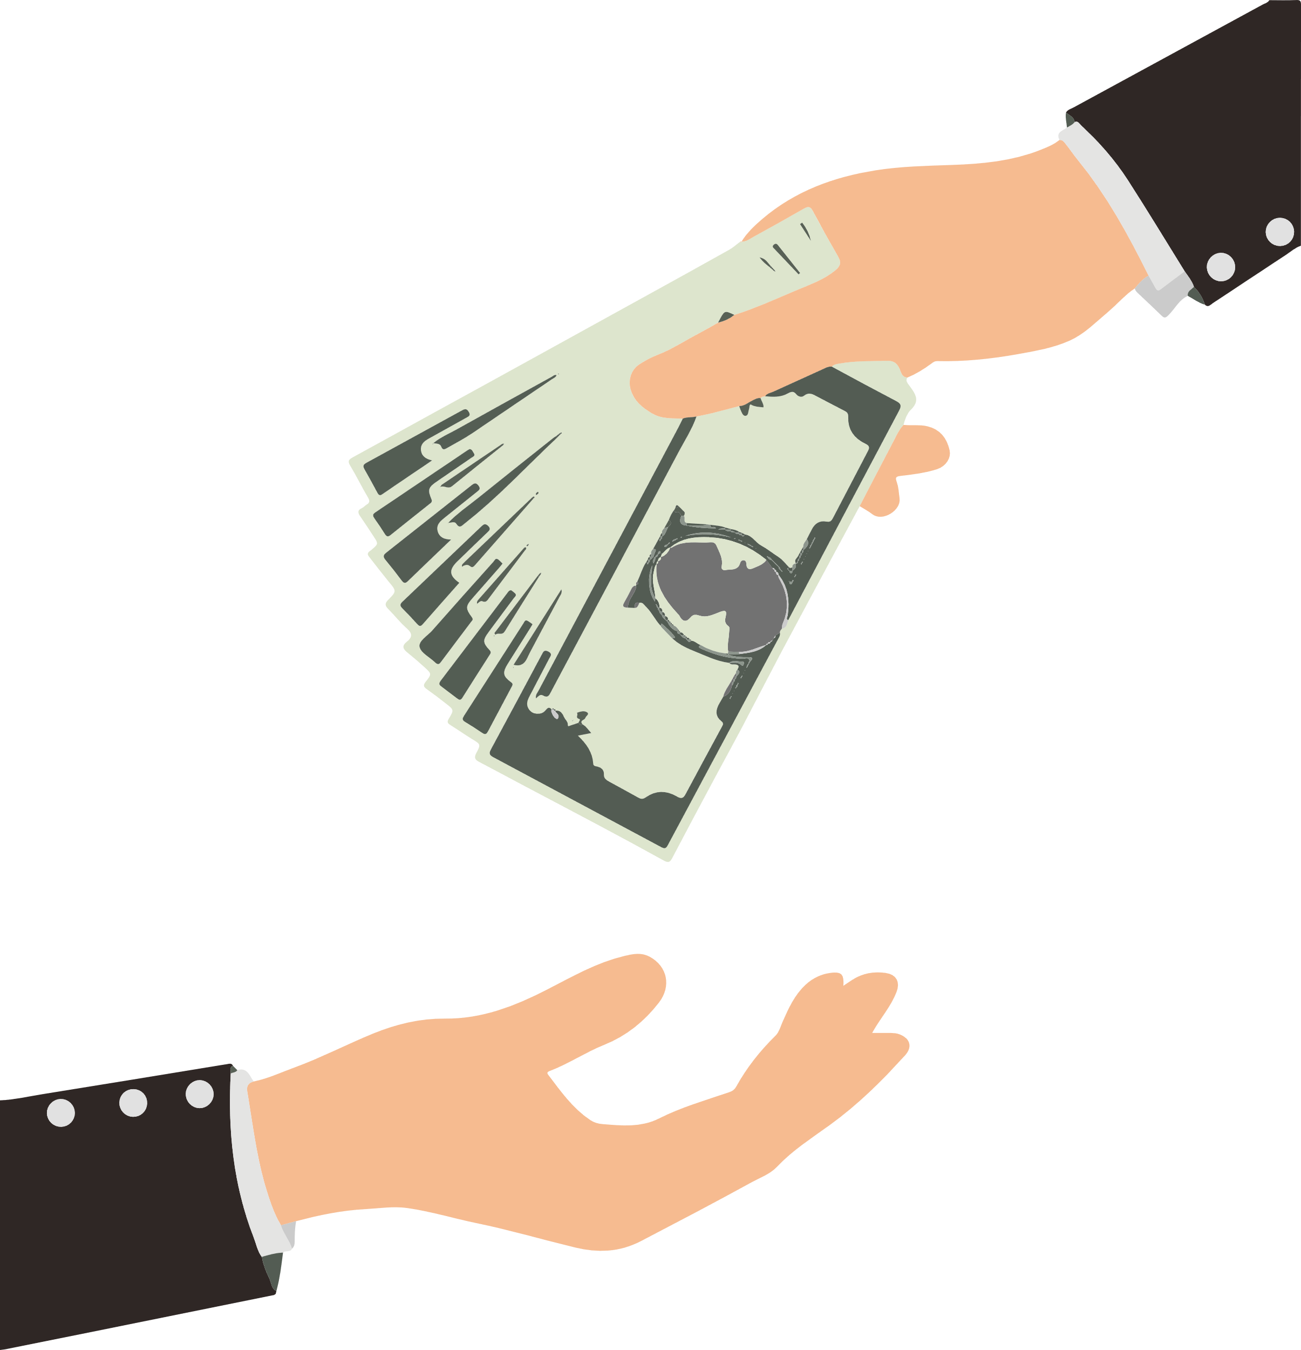
BONUS PAYMENT
There is an UNLIMITED amount of money to collect in each round and any money you collect you will receive as a BONUS PAYMENT at the end of the experiment! So try to collect as much as possible on each round!

Slide 14


Search For Money!

Slide 15
Search For Money! NO FEEDBACK

Slide 16
Break Time!
Feel free to take a break if you need to.
When you’re ready, place your right hand on the arrow keys and press the spacebar with your left to continue!
Spacebar

